Slide 1
Online Bus Ticket Management Modeling
Presented by Group 4
Kyi Sin Linn
Kyaw Pyae Sone
Mya Thet Chel
Linn Latt Hsu
Paing Paing Ko

Slide 2
Table of Contents
  Introduction
  Software Requirement Specification
  Requirement Analysis Modeling
  Scenario-Based Modeling
  Class-Based Modeling
  Conceptual Data Modeling
  Process Modeling
  Behavior Modeling
  Conclusion

Slide 3
Introduction
The traditional bus ticketing process often involves long queues, manual bookings, and a lack of real-time information. Recognizing the need for innovation, the Online Bus Ticket Management System is here to bridge the gap, providing a seamless and user-friendly solution for both travelers and bus operators.
Online Bus Ticket Management System, a revolutionary solution designed to enhance the efficiency and convenience of the travel industry. In a world that thrives on digital advancements, our system aims to redefine the way bus ticketing is managed and experienced.

Slide 4
Software Requirement Specification
Purpose
The purpose of this system is to provide customers with a convenient and efficient way to book bus tickets online. It offers features such as 24/7 availability, a wide range of options, secure transactions, a time-saving booking process, and the ability to cancel or reschedule tickets. The goal is to simplify the ticket booking process, enhance the customer experience, and provide a seamless and hassle-free way to arrange bus travel.

Slide 5
Functional Requirements
For Administrator
  Bus Route Management
  Bus Schedule Management
  Customer Detail Checking
  Ticket Management
For User
  Browse Ticket
  Customer Detail
  Display Available Seats
  Confirmation and Ticket Details
  Book Ticket
  Buy Ticket Online

Slide 6
Other Nonfunctional Requirements
Software Quality Requirement
Performance Requirement
Safety Requirement
Security Requirement
Business Rules

Slide 7
Requirement Analysis Modeling
Scenario-Based Modeling
Class-Based Modeling
Conceptual Data Modeling
Process Modeling
Behavior Modeling

Slide 8
Scenario-Based Modeling
Scenario-based modeling of SRS involves creating narratives that describe how users will interact with the system under specific conditions. These scenarios capture the system’s behavior from the user's perspective, detailing inputs, outputs, and expected system responses. We use scenario-based modeling because it helps uncover missing or ambiguous requirements in the SRS. By simulating real-world use cases, scenarios promote better understanding of user needs and identify potential issues before development begins.

Slide 9
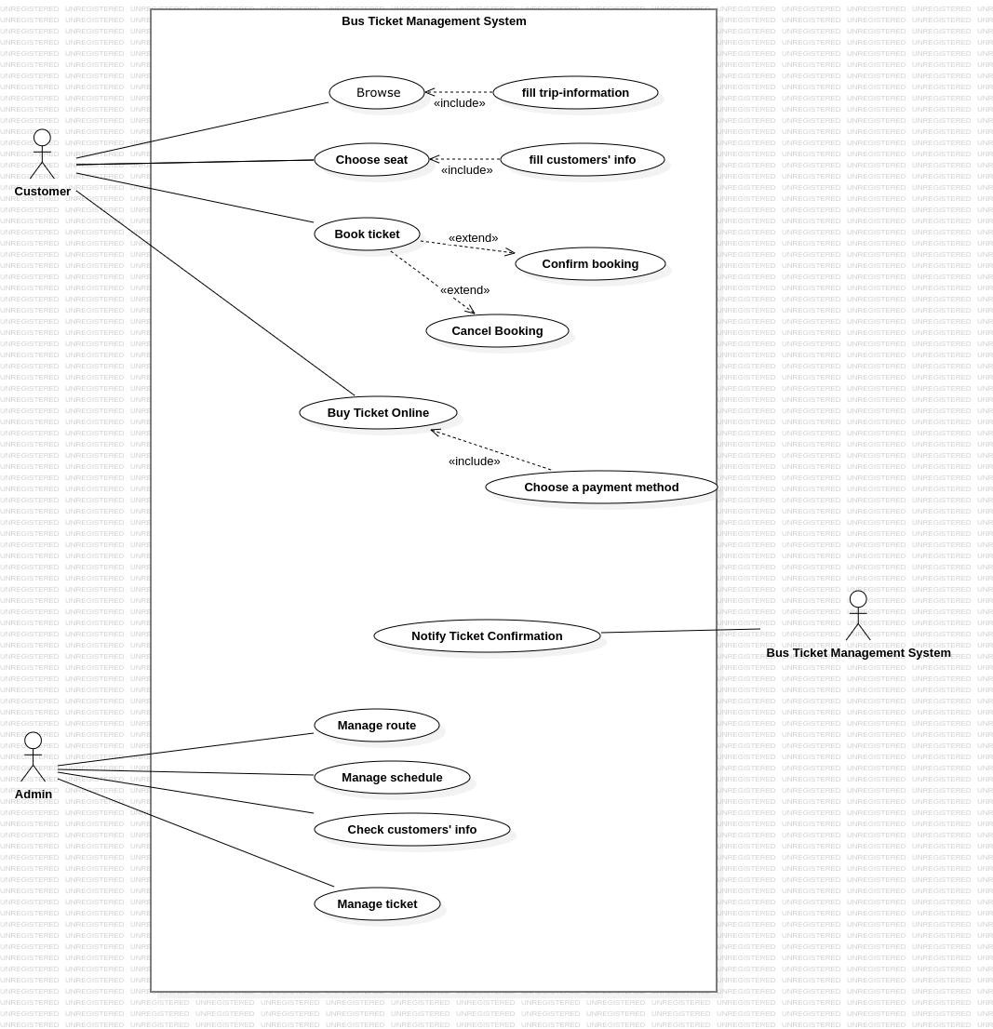
Use Case Diagram of Online Bus Ticket Management Modelling

Slide 10
Class-Based Modeling
An SRS (Software Requirements Specification) can be modeled using classes. This involves identifying the key entities (classes) and their attributes (data) within the system, along with the operations (methods) they can perform. This class-based model helps visualize the system's structure and how different parts interact. We use a class-based model because it promotes better understanding of the software's building blocks, simplifies communication between developers and stakeholders, and aids in early design decisions.

Slide 11
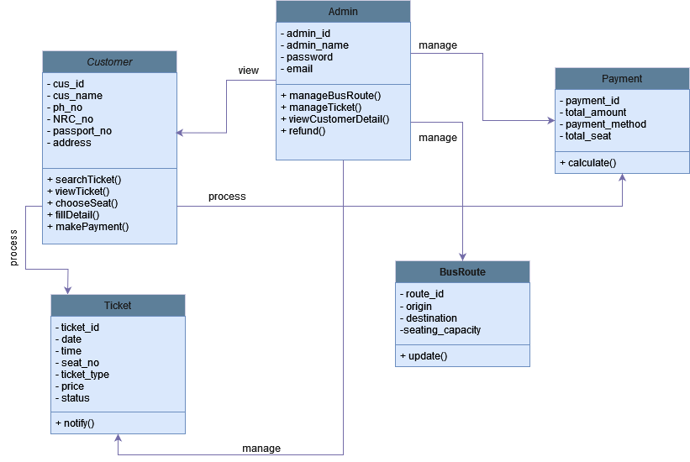
Class Diagram of Online Bus Ticket Management

Slide 12
Conceptual Data Modeling
A conceptual model of an SRS focuses on the high-level entities, attributes, and relationships within the software system, independent of specific technologies . It represents the core functionalities and data involved, using concepts like users, functionalities, data items, and their interactions . This high-level view helps stakeholders understand the overall system behavior and requirements before diving into technical details . By focusing on core concepts, a conceptual model promotes clear communication and ensures everyone aligns on the system's fundamental purpose.

Slide 13
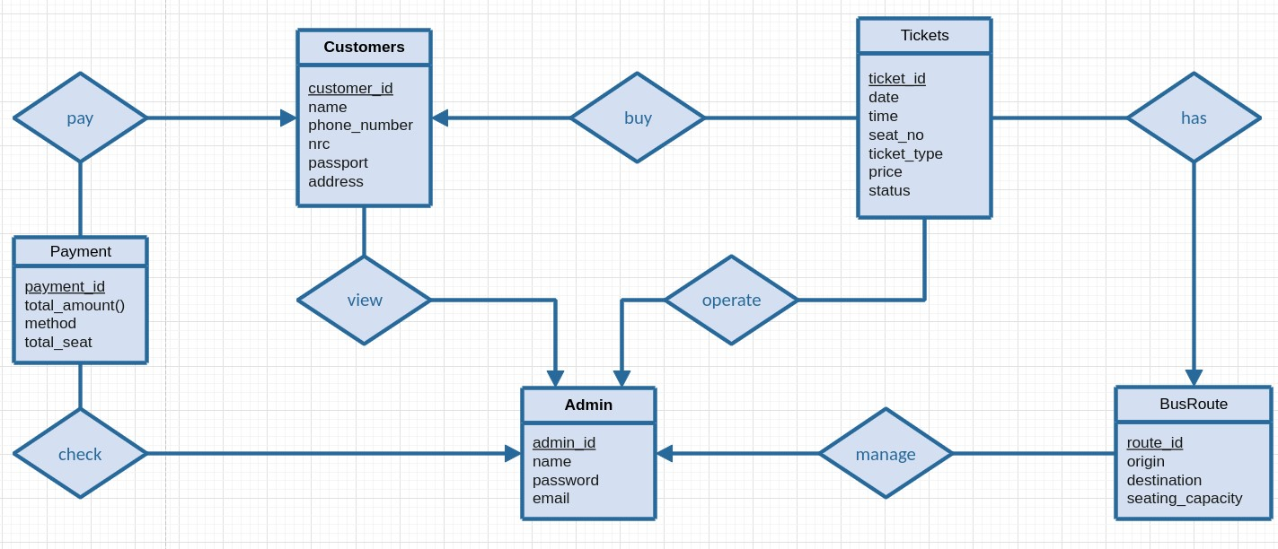
E-R Diagram of Online Bus Ticket Management

Slide 14
Process Modeling
This data flow diagram describes the way information flows through the process. It includes data inputs and outputs, data stores, and the various sub processes the data moves through.

Slide 15
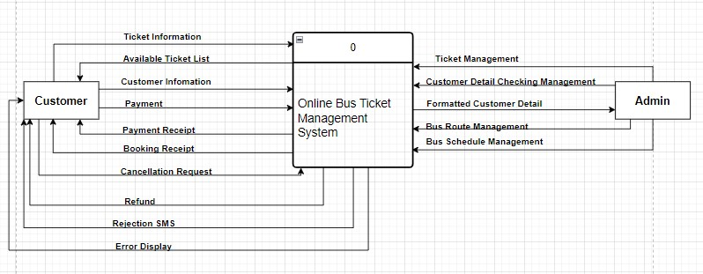
Context DFD of Bus Ticket Management
the most basic data flow diagrams
represents all the external components of the system
describe the scope of the project

Slide 16
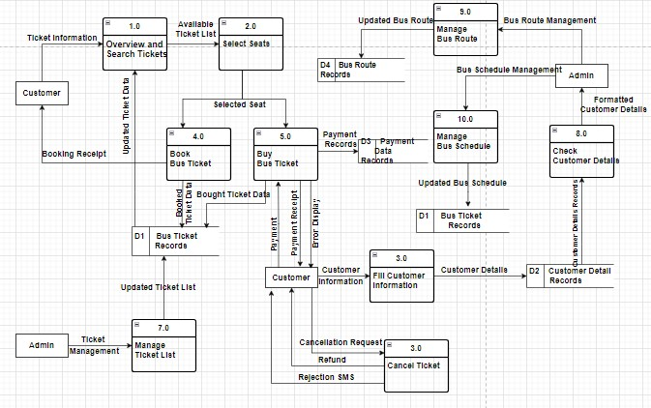
Level 0 Diagram
detailed description of the context diagram
represents the primary individual processes in the system at the highest possible level of detail
Level-0 DFD of Bus Ticket Management

Slide 17
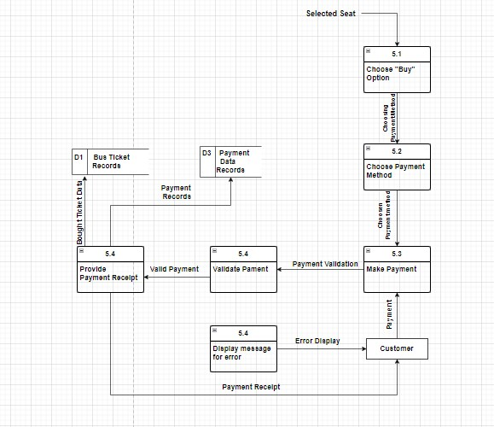
Level 1 Diagram
provides greater detail, focusing on a system's main functions
Level 1 DFD for Payment Process

Slide 18
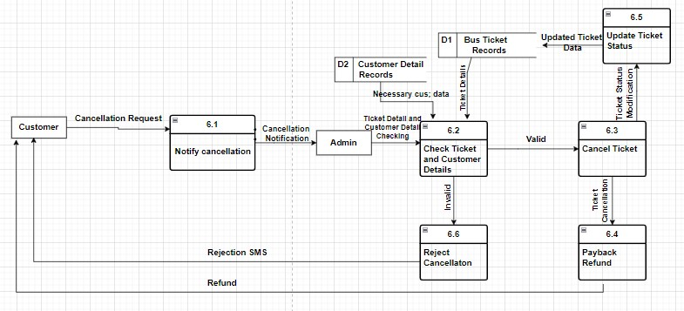
Level 1 Diagram(Cont’d)
Level 1 DFD for Cancel Ticket Process

Slide 19
Behavior Modeling
Behavioral modeling of an SRS dives into how the system reacts to events. This can be through a state transition diagram where the system transitions between states (active, inactive, etc.) based on user actions or external triggers.
These diagrams depict the flow of the system's behavior, allowing for a clear understanding of how different scenarios play out.
Behavioral modeling helps identify potential issues and ensures the SRS captures the expected system responses.

Slide 20
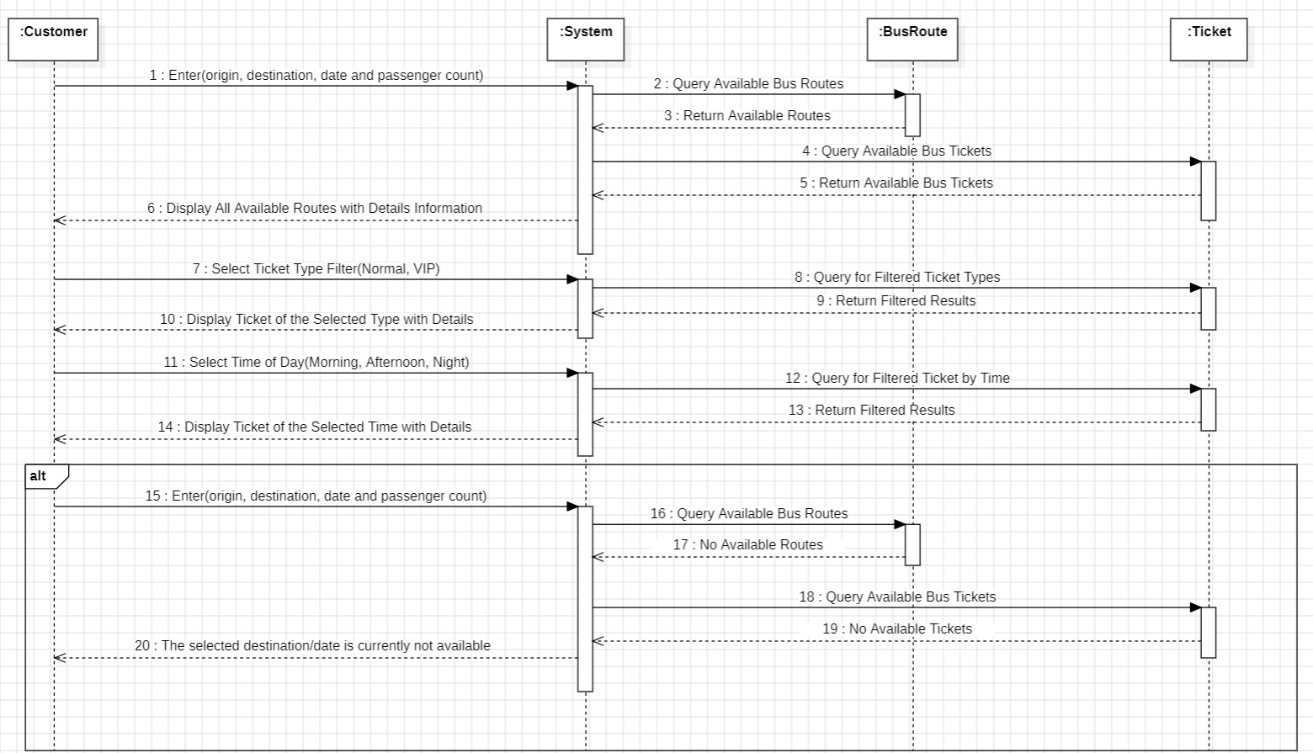
Sequence diagram of Overview the system

Slide 21
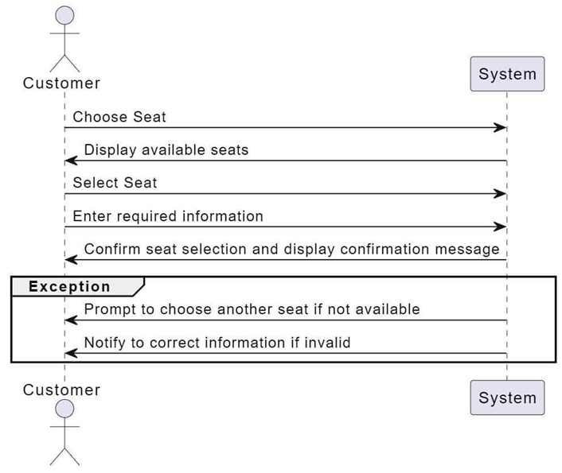
Sequence Diagram of Choose Seat

Slide 22
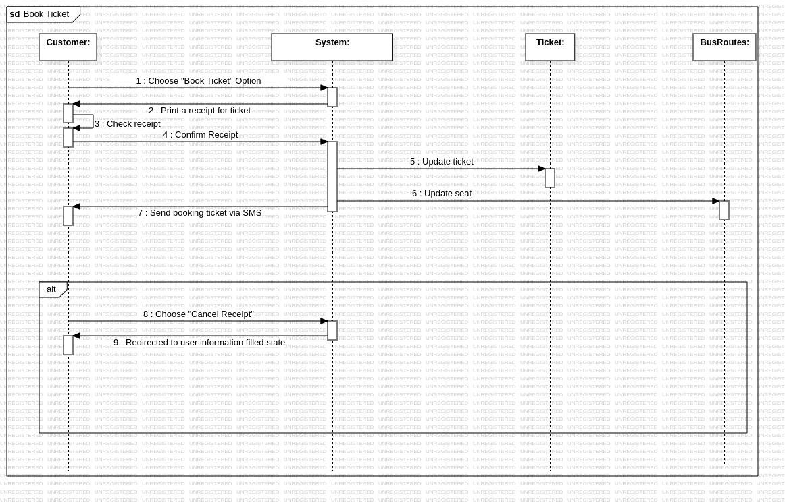
Sequence Diagram of Book Ticket

Slide 23
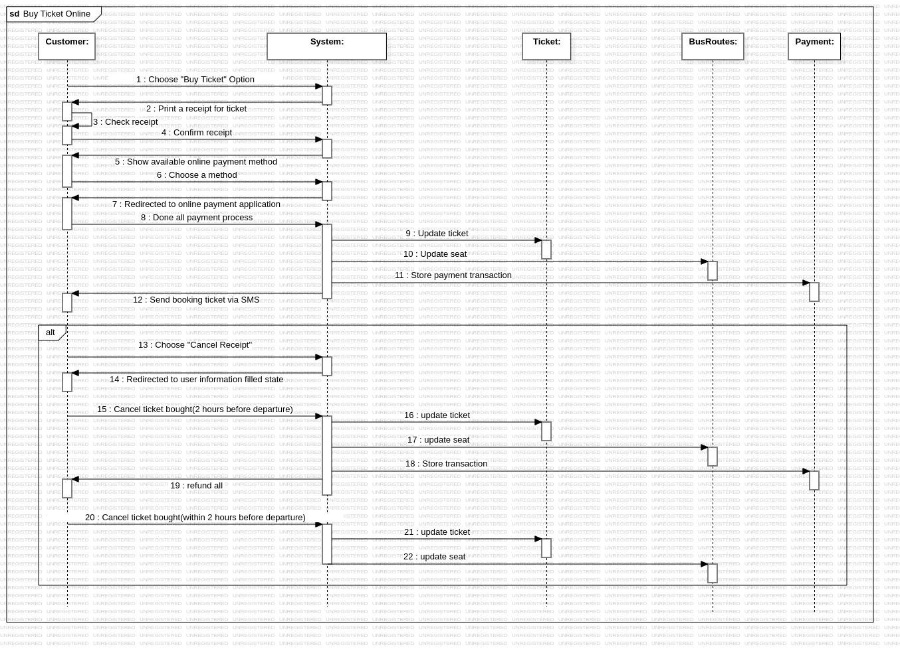
Sequence Diagram of Buy Ticket Online

Slide 24
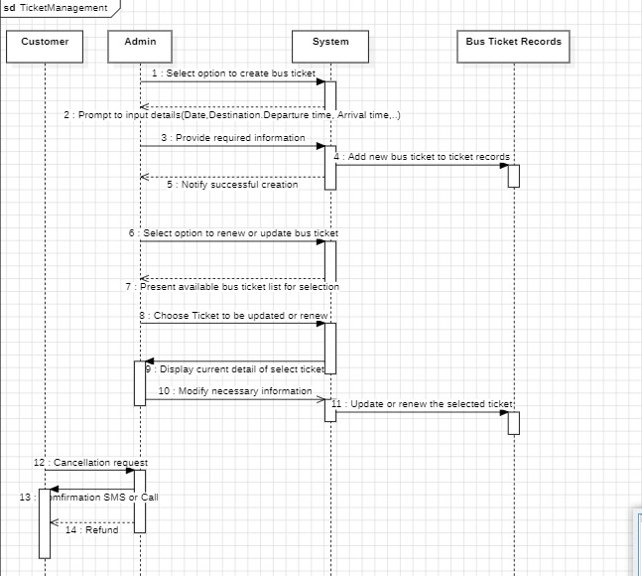
Sequence Diagram of Ticket Management

Slide 25
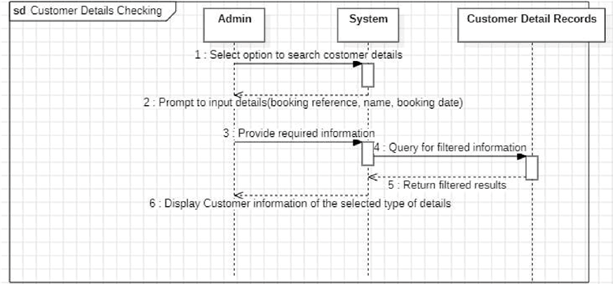
Sequence Diagram of Customer Detail Checking

Slide 26
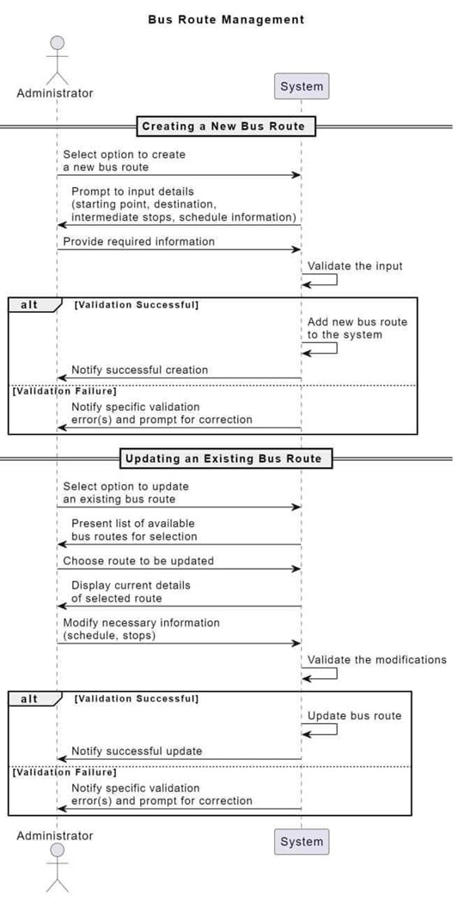
Sequence Diagram of Bus Route Management

Slide 27
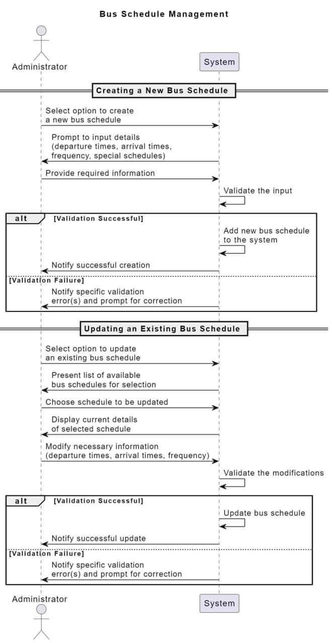
Sequence Diagram of Bus Schedule Management System

Slide 28
Conclusion
In conclusion, our next step is to focus on completing the design modeling, which will greatly enhance the functionality and user experience of our Bus Ticket Management System. This crucial future work promises to bring innovative solutions and improvements, ensuring our system meets the needs of our users.

